Slide 1
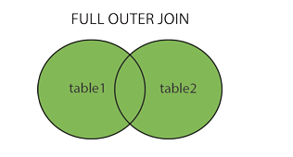
SQL FULL OUTER JOIN
The FULL OUTER JOIN keyword return all records when there is a match in left (table1) or right (table2) table records.
The FULL OUTER JOIN keyword returns all matching records from both tables whether the other table matches or not.
FULL OUTER JOIN can potentially return very large result-sets!
FULL OUTER JOIN Syntax
SELECT column_name(s) FROM table1 FULL OUTER JOIN table2 ON table1.column_name = table2.column_name WHERE condition;

